Slide 1
Presentation Template
for my Ph.D Viva-Voce Examination
J Justina Michael

Slide 2
HierbaNetV1: A Novel Feature Extraction Framework for Deep Learning-Based
Weed Identification
Research Candidate
J Justina Michael (RA2113003011030),
Full Time Research Scholar,
Department of Networking and Communications,
SRMIST - Kattankulathur.
Research Supervisor
Dr. M. Thenmozhi,
Professor,
Department of Networking and Communications,
SRMIST - Kattankulathur.

Slide 3
Presentation Overview
01 - Introduction
02 - Research objectives
03 - Proposed framework
04 - Objective - 1: Literature review, research gap, contributions and results
05 - Objective - 2: Literature review, research gap, contributions and results
06 - Objective - 3: Literature review, research gap, contributions and results
07 - Conclusion
08 - Future work
09 - Publications
10 - References

Slide 4
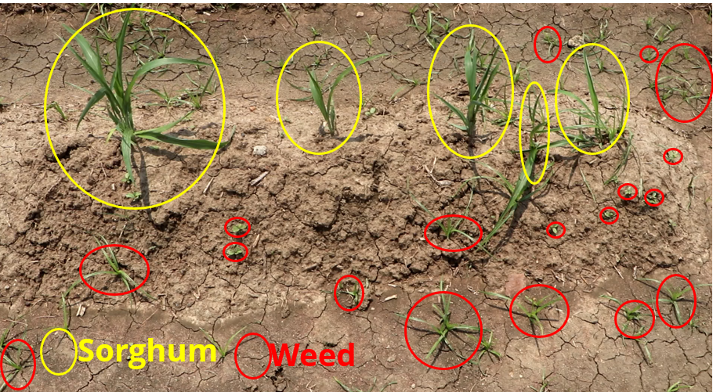
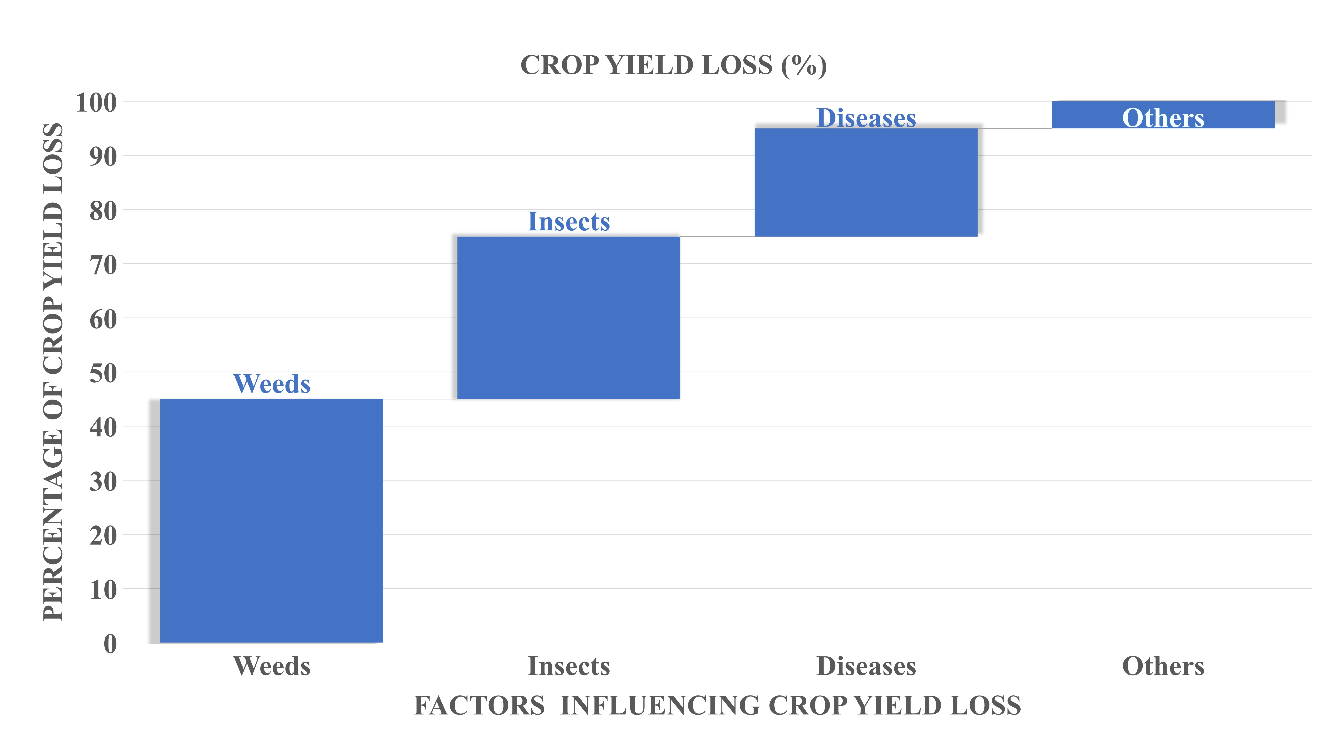
01. Introduction
AI-based weeding is a sustainable alternative to manual methods
Weed infestation leads to reduced crop yields and increased labor costs
Fig 1.1. Presence of crops and weeds in Sorghum field - Research experimental area
Fig 1.2. Crop yield loss [1]

Slide 5
02. Objectives
Motivation: AI for weed identification in Indian farms
Objective 1: To create crop-weed image datasets from the Indian agricultural field for weed identification.
Objective 2: To design a novel feature extraction technique for varying-sized Region-of-Interests in sorghum-weed image datasets.
Objective 3: To design a feature pyramid network that generates rich semantic features for fine-grained object localization.

Slide 6
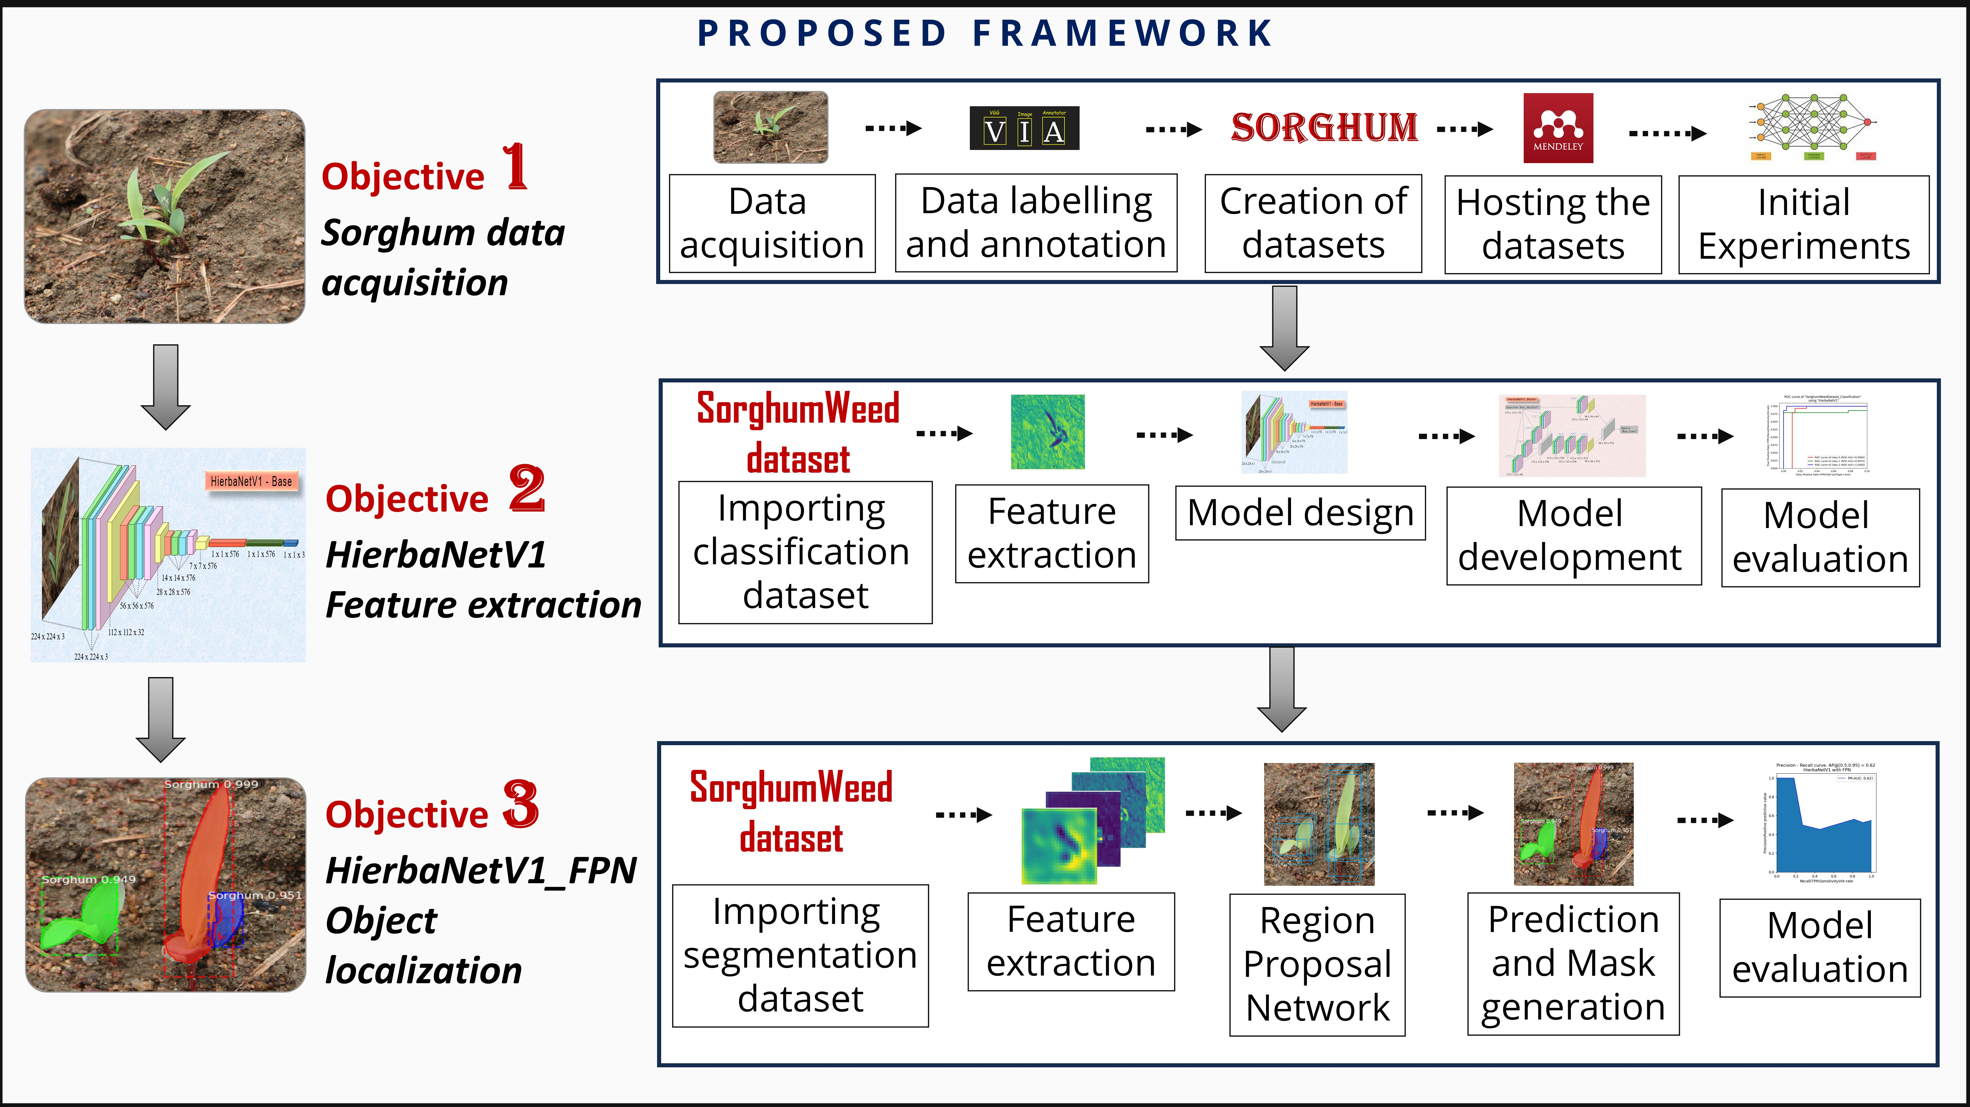
03. Proposed framework
Fig 3.1. Proposed framework

Slide 7
Objective 1

Slide 8
04. Objective 1 : Sorghum-Weed dataset creation
Literature review
# | Dataset | Geograp. Location | Duration | Images | Species | Purpose
1
2
3
4
5
6
7
8

Slide 9
04. Objective 1 : Sorghum-Weed dataset creation
Problem statement - 01
There is no publicly available crop-weed research dataset from Indian agricultural fields
Objective - 01
To create crop-weed image datasets from the Indian agricultural field for weed identification.
Published an article entitled “SorghumWeedDataset_Classification And SorghumWeedDataset_Segmentation Datasets For Classification, Detection, and Segmentation In Deep Learning” in a SCI indexed Elsevier journal “Data in Brief” on 09.12.2023 with ImpactFactor 1.2 and CiteScore 2.6. https://doi.org/10.1016/j.dib.2023.109935
Michael, Justina; M, Thenmozhi (2023), “SorghumWeedDataset_Classification”, Mendeley Data, V1, doi: 10.17632/4gkcyxjyss.1
Michael, Justina; M, Thenmozhi (2023), “SorghumWeedDataset_Segmentation”, Mendeley Data, V1, doi: 10.17632/y9bmtf4xmr.1

Slide 10
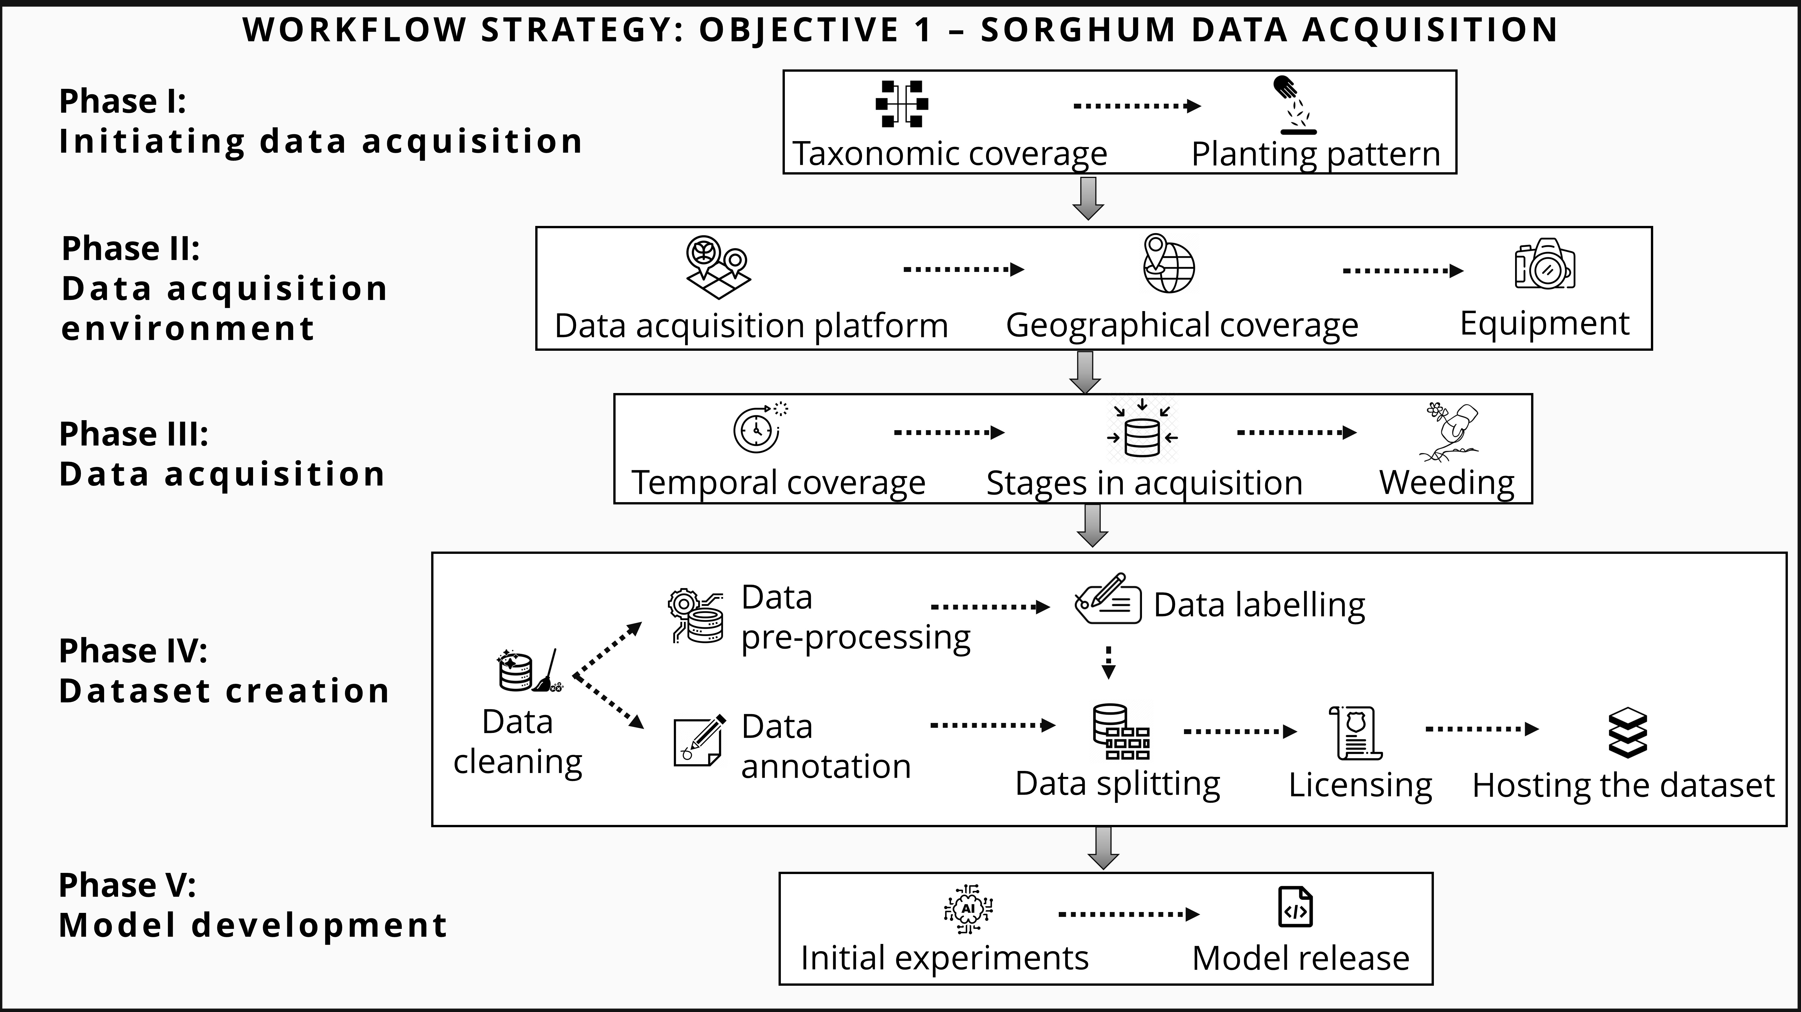
04. Objective 1 : Sorghum-Weed dataset creation
Fig 4.1. Workflow strategy of sorghum data acquisition

Slide 11
04. Objective 1 : Sorghum-Weed dataset creation
Phase I: Taxonomic coverage
…
…
…
…
…
…
…

Slide 12
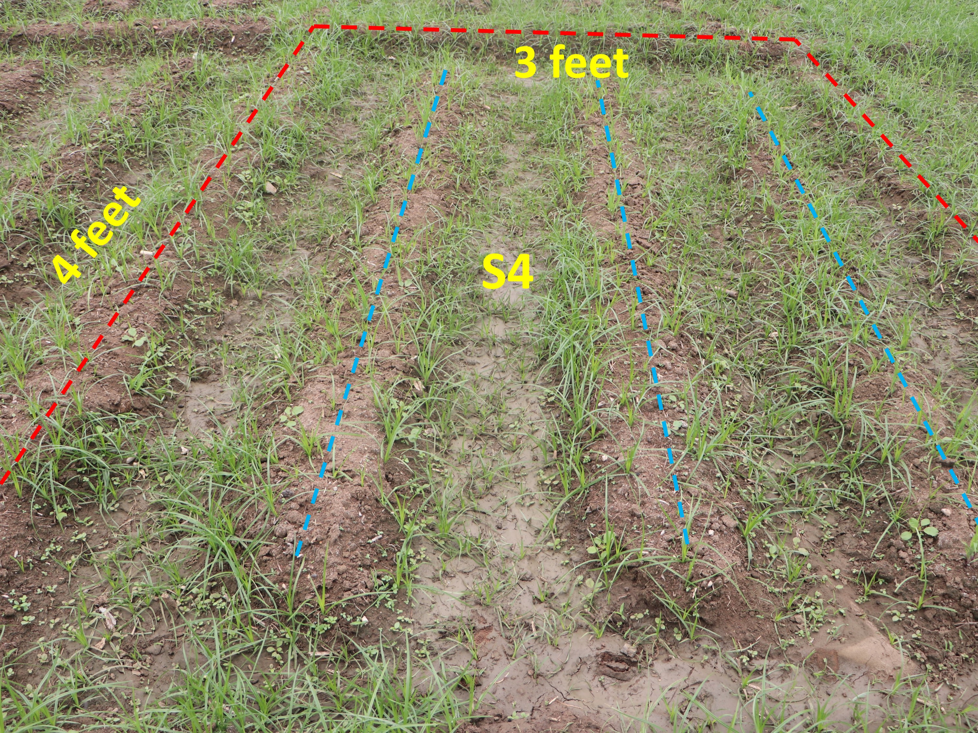
04. Objective 1 : Sorghum-Weed dataset creation
Phase I: Planting pattern I
Purpose
…..
TABLE 4.1. Planting pattern for dibbling system
Planting attributes | Values
Fig 4.2. Planting pattern I - Actual S4 plot on Day 15 after sowing

Slide 13
04. Objective 1 : Sorghum-Weed dataset creation
Phase V: Building an AI model
Initial Experimentation - Results
TABLE 4.12. Performance of Pre-trained models on ‘SorghumWeedDataset_Classification’
Model / Metrics | Training Loss | Training Accuracy | Validation Loss | Validation Accuracy | Testing loss | Testing accuracy
DenseNet201 [11]
VGG19 [12]
MobileNetV2 [13]
ResNet152V2 [14]
Published a code capsule entitled “CNN_Sorghum_Weed_Classifier: An Artificial Intelligence-based Software for Pre-processing and Experimenting 'SorghumWeedDataset_Classification' dataset in Python“in Code Ocean on 15.12.2023 with DOI https://doi.org/10.24433/CO.7479881.v1

Slide 14
04. Objective 1 : Sorghum-Weed dataset creation
Research outcome of objective-1
…
…
…

Slide 15
Objective - 2

Slide 16
05. Objective 2: HierbaNetV1-Feature extractor
Literature review
# | Reference | Yr | Architecture | Inference | Limitations
9
10
11
12

Slide 17
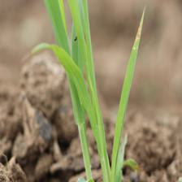
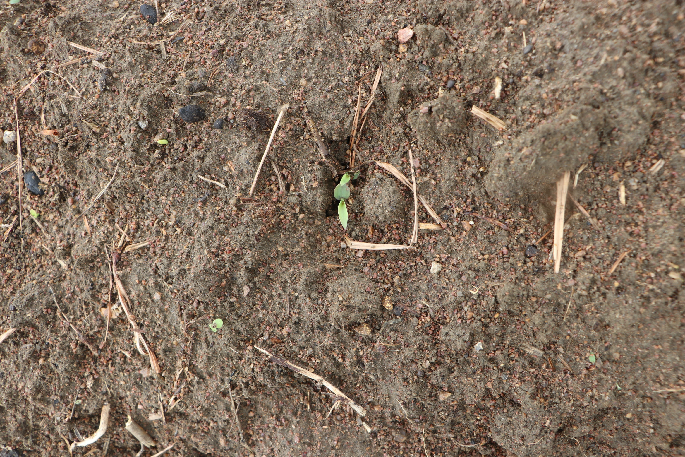
05. Objective 2: HierbaNetV1-Feature extractor
Problem statement - 02
Feature extraction methods focus on a specific degree of complexity thus preventing to identify ROIs of all sizes.
Objective - 02
To create HierbaNetV1 - a novel feature extraction technique that extracts significant representations from varying-sized Region-of-Interests.
(a)
(b)
Fig 5.1 Samples with varying sized ROIs
Michael J,Manivasagam T. 2024. HierbaNetV1: a novel feature extraction framework for deep learning-based weed identification. PeerJ Comput. Sci. 10:e2518 DOI 10.7717/peerj-cs.2518 [Q1, PeerJ Computer Science, SCI, IF-3.8, CS-4.2]
Published an article entitled “HierbaNetV1: A novel convolutional neural network architecture” in the journal “Science Talks”, Elsevier on Jan 2024. https://doi.org/10.1016/j.sctalk.2024.100316
Filed the provisional specification of the patent entitled “HierbaNetV1: A CNN-based customized architecture with intensive feature extraction for classification” in Indian Patent Office with Patent application no. 202441050194 on 01.07.2024.

Slide 18
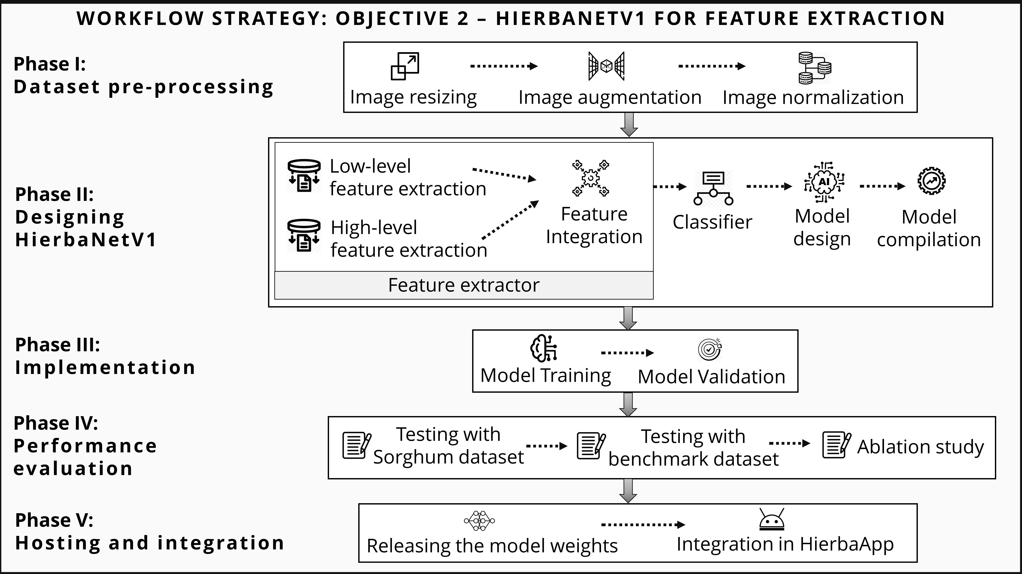
05. Objective 2: HierbaNetV1-Feature extractor
Fig 5.2. Workflow strategy of HierbaNetV1 for feature extraction

Slide 19
05. Objective 2: HierbaNetV1-Feature extractor
Phase I: Dataset Pre-processing
TABLE 5.1. Pre-processing ‘SorghumWeedDataset_Classification’ dataset for feature extraction with HierbaNetV1
Methods | Values

Slide 20
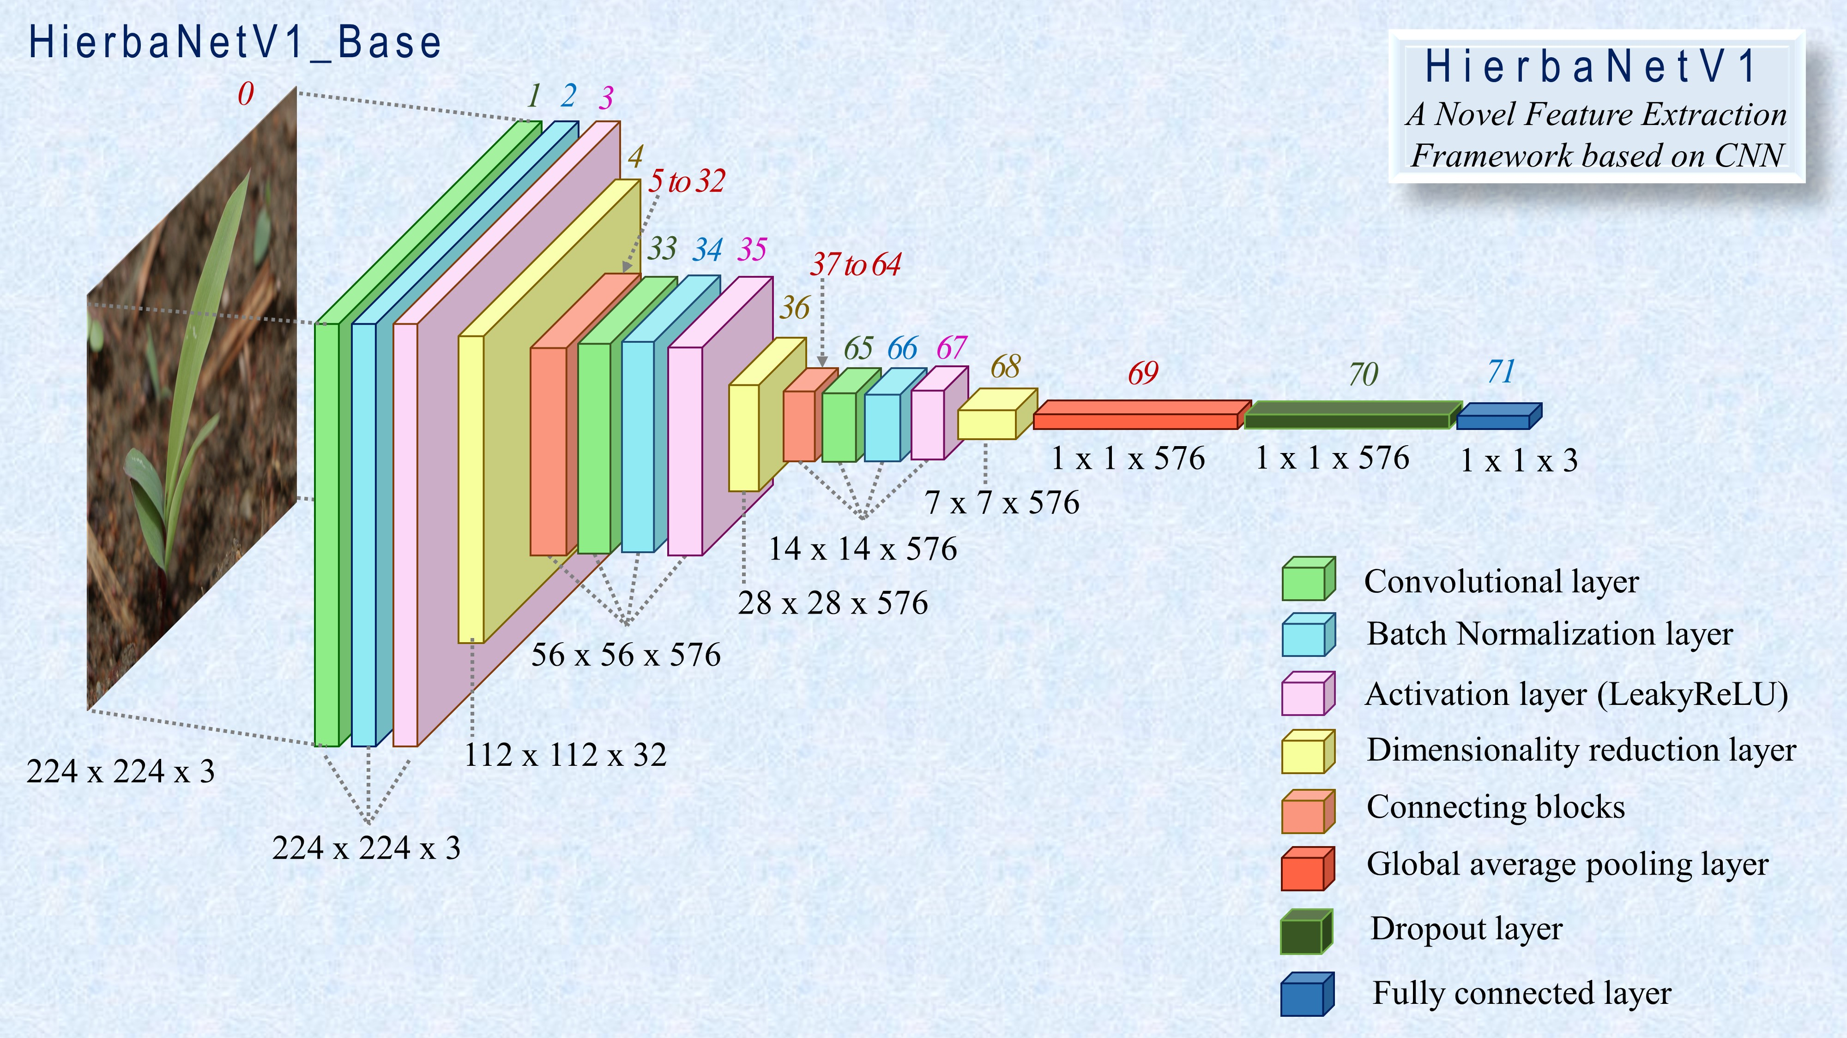
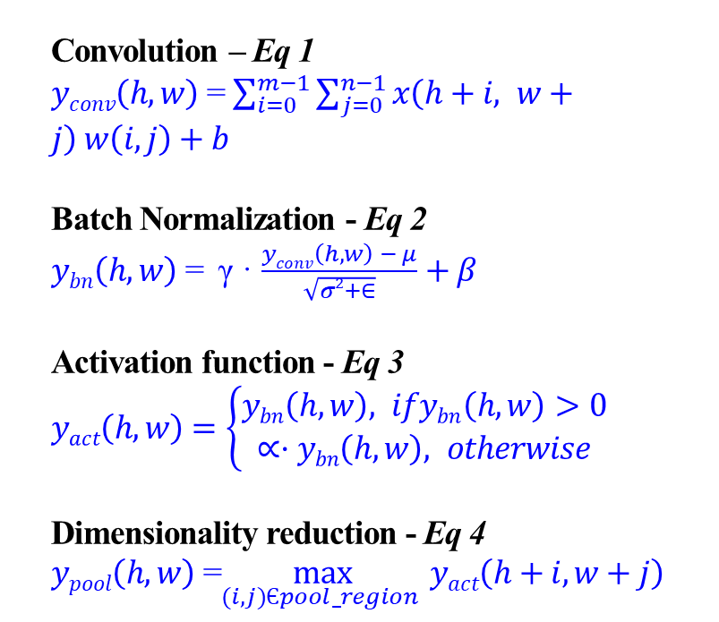
05. Objective 2: HierbaNetV1-Feature extractor
Phase II: Design HierbaNetV1
Ideation: To perform intensive feature extraction focusing on multiple levels of complexity, irrespective of the ROI size, and emphasize low-level features consistently.
Convolution – Eq 1
$yconv\left(h,w\right)$ = $\sum_{i=0}^{m−1}{\sum_{j=0}^{n−1}{x\left(h+i, w+j\right) w\left(i, j\right)+b}}$
Batch Normalization - Eq 2
$ybn\left(h,w\right)$ = γ · $\frac{yconv\left(h,w\right) − μ}{\sqrt{σ2+∈}}+β$
Activation function - Eq 3
$yact\left(h,w\right)$ $=\left\{\begin{aligned}ybn\left(h,w\right), ifybn\left(h,w\right)>0 \\ ∝·ybn\left(h,w\right), otherwise\end{aligned}\right.$
Dimensionality reduction - Eq 4
$ypool\left(h,w\right)$ =$\max_{(i,j)Єpool_region }{yact\left(h+i,w+j\right)}$
Fig 5.3. Architecture of HierbaNetV1

Slide 21
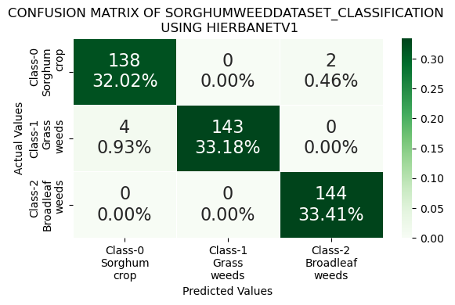
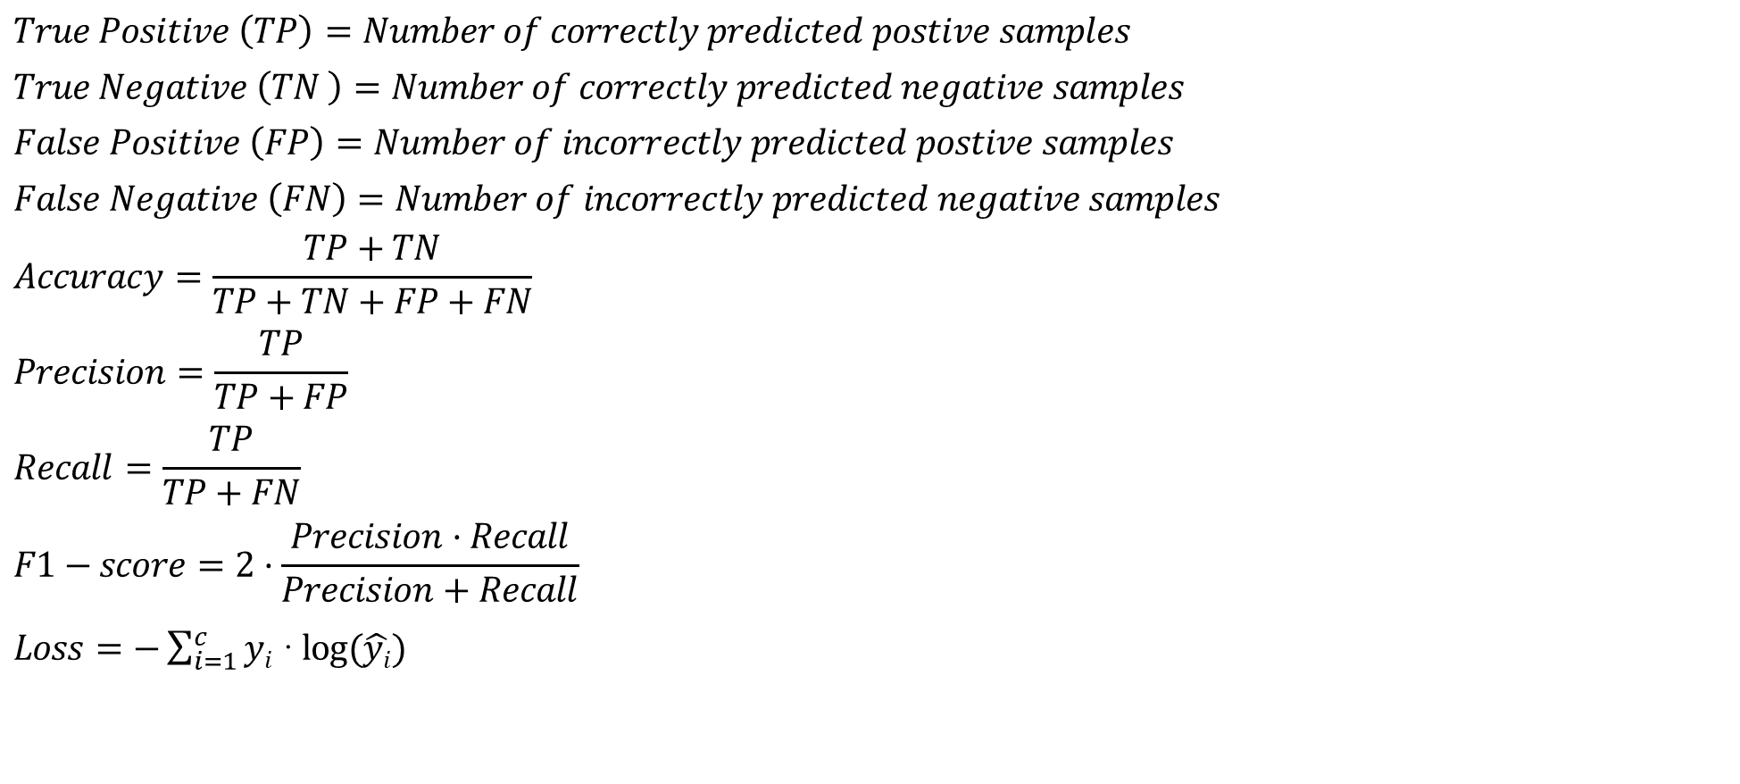
05. Objective 2: HierbaNetV1-Feature extractor
Phase IV: Performance evaluation - Metrics for model evaluation
$$True Positive \left(TP\right)=Number of correctly predicted postive samples$$
$$True Negative \left(TN \right)=Number of correctly predicted negative samples$$
$$False Positive \left(FP\right)=Number of incorrectly predicted postive samples$$
$$False Negative \left(FN\right)=Number of incorrectly predicted negative samples$$
$$Accuracy=\frac{TP+TN}{TP+TN+FP+FN}$$
$$Precision=\frac{TP}{TP+FP}$$
$$Recall=\frac{TP}{TP+FN}$$
$$F1−score=2·\frac{Precision·Recall}{Precision+Recall}$$
$Loss=−\sum_{i=1}^{c}{yi}$ · $\log{(\hat{yi})}$
Fig 5.11. Confusion matrix of ‘SorghumWeedDataset_ Classification using HierbaNetV1

Slide 22
05. Objective 2: HierbaNetV1-Feature extractor
Research outcome of objective-2
…
…
…

Slide 23
Objective - 3

Slide 24
06. Objective 3: HierbaNetV1_MRCNN for Object Localization
Literature review
# | Reference | Yr | Architecture | Inference | Limitations
14
16
17
18

Slide 25
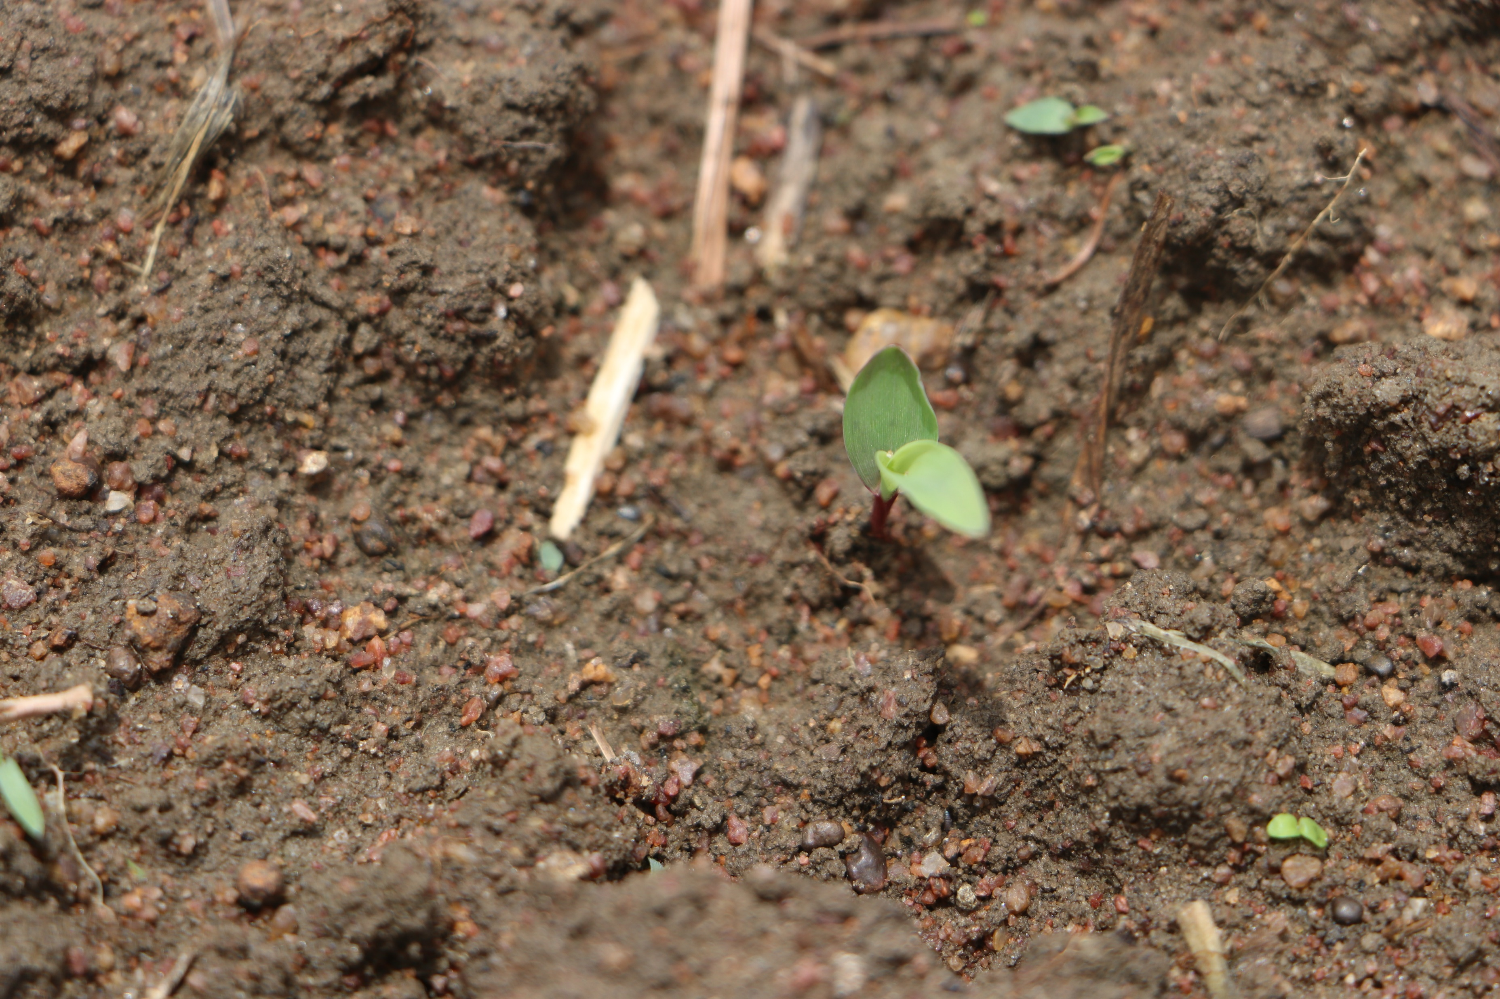
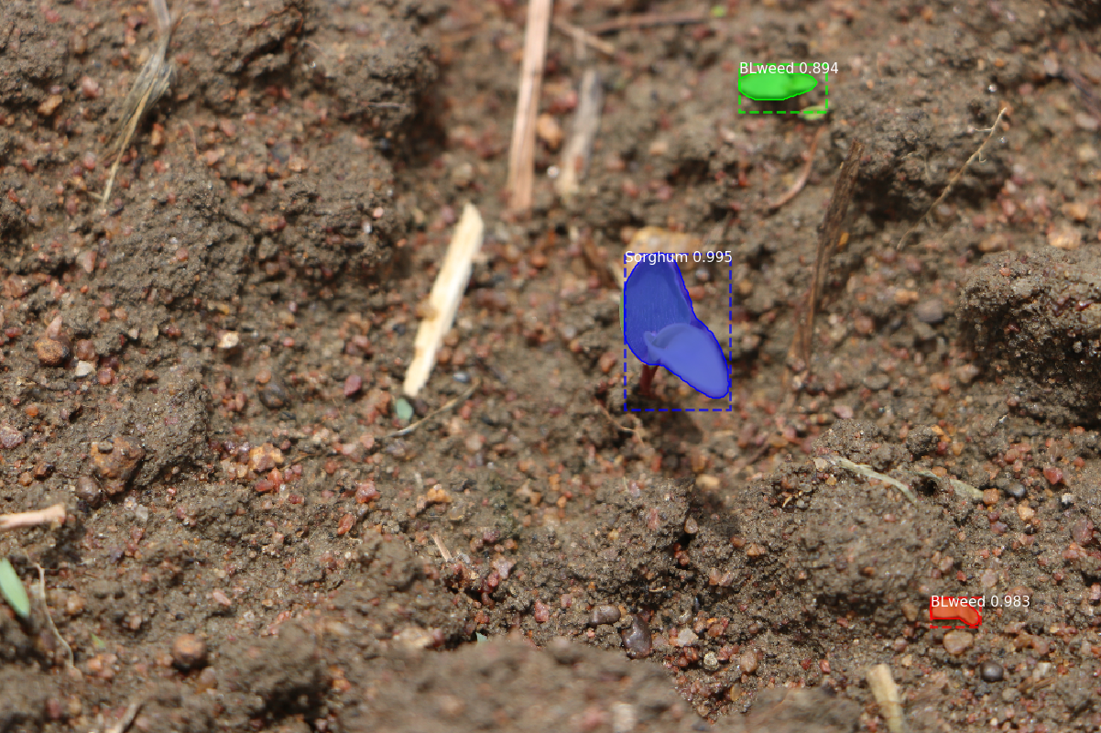
06. Objective 3: HierbaNetV1_MRCNN for Object Localization
Research Gap:
Finer object localization for small objects are harder as the feature pyramid network performs down sampling and up sampling frequently.
Objective 3:
To build HierbaNetV1_FPN - a feature pyramid network that generates rich semantic features for fine-grained object localization.
Fig 6.1. Precise Localization and Segmentation
HierbaNetV1_MRCNN: A customized instance segmentation architecture for crop-weed segmentation” is submitted to the journal

Slide 26
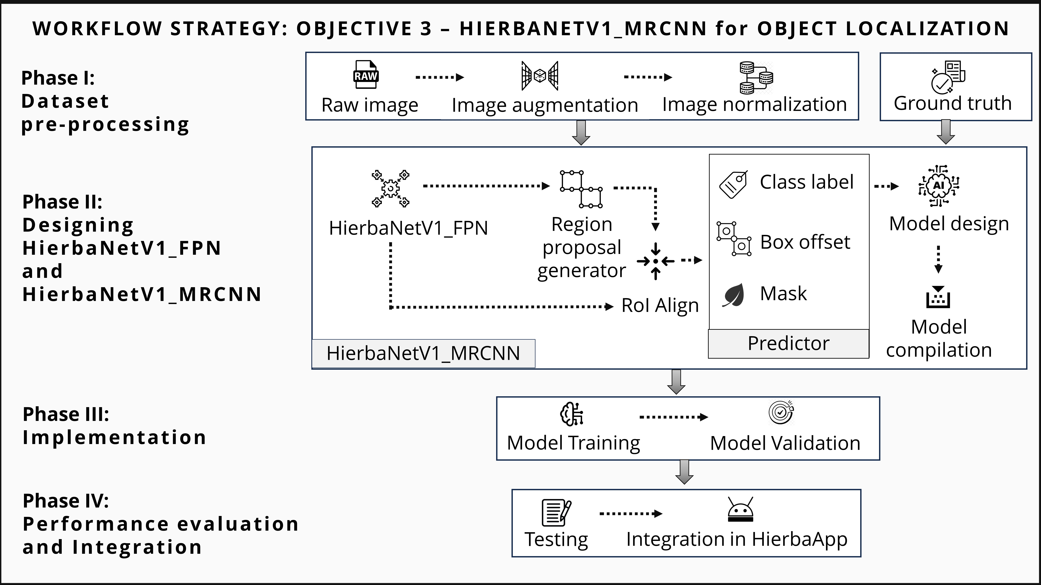
06. Objective 3: HierbaNetV1_MRCNN for Object Localization
Fig 6.2. Workflow strategy of HierbaNetV1_MRCNN withHierbaNetV1_FPN for object localization

Slide 27
06. Objective 3: HierbaNetV1_MRCNN for Object Localization
Phase I: Dataset Pre-processing
TABLE 6.1. Pre-processing methods of ‘SorghumWeedDataset_Segmentation’ for HierbaNetV1_MRCNN training
Methods | Values

Slide 28
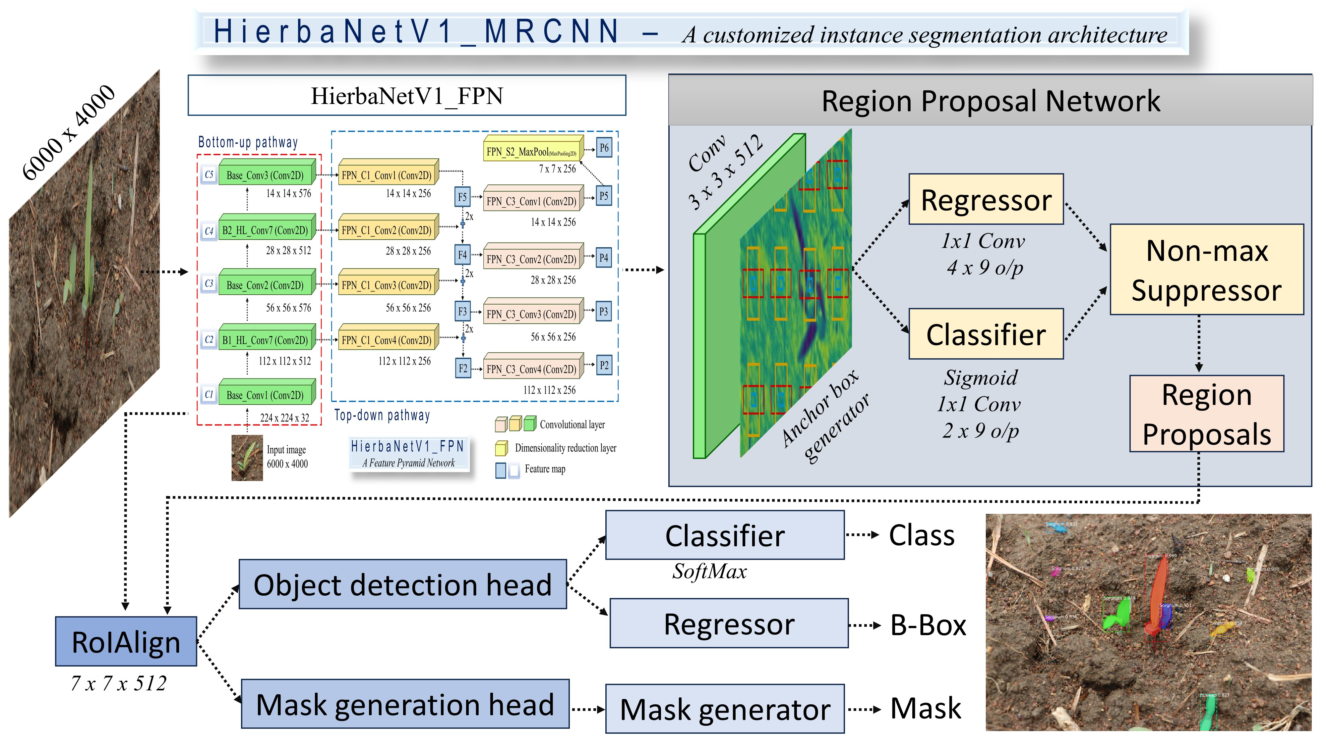
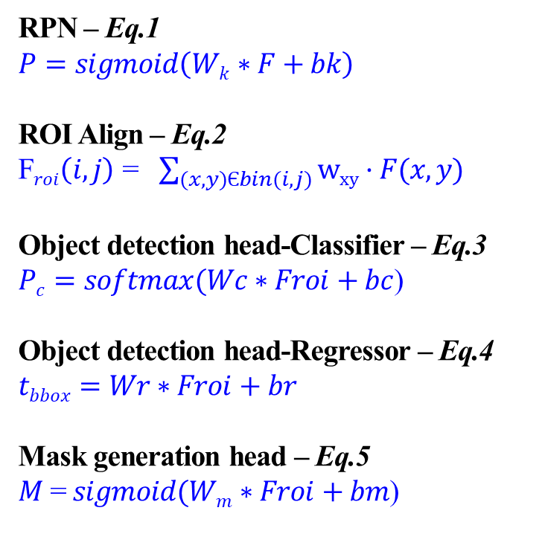
06. Objective 3: HierbaNetV1_MRCNN for Object Localization
Phase II: Designing HierbaNetV1_MRCNN
RPN – Eq.1
$P=sigmoid\left(Wk∗F+bk\right)$
ROI Align – Eq.2
F$roi\left(i,j\right)$ = $\sum_{(x,y)Єbin(i,j)}{wxy·F(x,y)}$
Object detection head-Classifier – Eq.3
$Pc=softmax(Wc∗Froi+bc$)
Object detection head-Regressor – Eq.4
$$tbbox=Wr∗Froi+br$$
Mask generation head – Eq.5
$M$ =$\operatorname{sigmoid}{(Wm∗Froi+bm}$)
Fig 6.4. Architecture of HierbaNetV1_MRCNN

Slide 29
06. Objective 3: HierbaNetV1_MRCNN for Object Localization
Research outcome of objective-3
…
…
…

Slide 30
07. Conclusion
…
…
…

Slide 31
08. Future Enhancements
…
…
…

Slide 32
09. Publications
JOURNAL ARTICLES
…
…
…
CONFERENCE PROCEEDINGS
…
…
…

Slide 33
10. References
…
…

Slide 34
Thank You

